Slide 1

CS244a: An Introduction to Computer Networks
Handout 8:
Congestion Avoidance and
Active Queue Management
Nick McKeown
Professor of Electrical Engineering
and Computer Science, Stanford University
nickm@stanford.edu
http://www.stanford.edu/~nickm

Slide 2
Congestion Avoidance
TCP reacts to congestion after it takes place. The data rate changes rapidly and the system is barely stable (or is even unstable).
Can we predict when congestion is about to happen and avoid it? E.g. by detecting the knee of the curve.
Average
Packet delay
Load

Slide 3
Congestion Avoidance Schemes
Router-based Congestion Avoidance:
  DECbit:
    Routers explicitly notify sources about congestion.
  Random Early Detection (RED):
    Routers implicitly notify sources by dropping packets.
    RED drops packets at random, and as a function of the level of congestion.
Host-based Congestion Avoidance
  Source monitors changes in RTT to detect onset of congestion.
  A variety of algorithms are described in Section 6.4.3.

Slide 4
DECbit
Each packet has a “Congestion Notification” bit called the DECbit in its header.
If any router on the path is congested, it sets the DECbit.
  Set if average queue length >= 1 packet, averaged since the start of the previous busy cycle.
To notify the source, the destination copies DECbit into ACK packets.
Source adjusts rate to avoid congestion.
  Counts fraction of DECbits set in each window.
  If <50% set, increase rate additively.
  If >=50% set, decrease rate multiplicatively.
Queue
Length
at router
Time
Averaging period

Slide 5
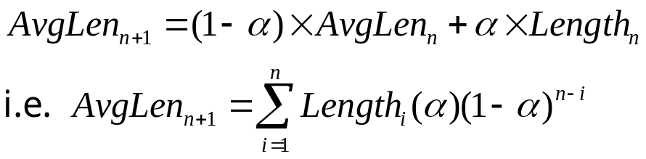
Random Early Detection (RED)
RED is based on DECbit, and was designed to work well with TCP.
RED implicitly notifies sender by dropping packets.
Drop probability is increased as the average queue length increases.
(Geometric) moving average of the queue length is used so as to detect long term congestion, yet allow short term bursts to arrive.

Slide 6
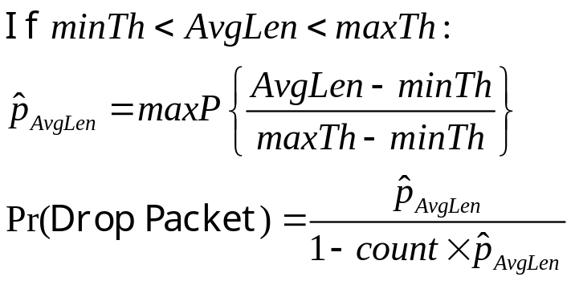
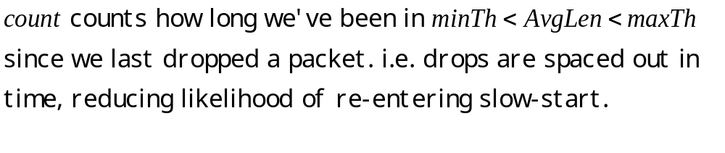
RED Drop Probabilities
D(t)
A(t)
1
maxP
AvgLen
minTh
maxTh

Slide 7
Properties of RED
Drops packets before queue is full, in the hope of reducing the rates of some flows.
Drops packet for each flow roughly in proportion to its rate.
Drops are spaced out in time.
Because it uses average queue length, RED is tolerant of bursts.
Random drops hopefully desynchronize TCP sources.

Slide 8

Synchronization of sources
RTT
A
B
C
D
Source A

Slide 9
Synchronization of sources
RTT
A
B
C
D
Aggregate Flow
f(RTT)
Avg

Slide 10
Desynchronized sources
RTT
A
B
C
D
Source A

Slide 11
Desynchronized sources
RTT
A
B
C
D
Aggregate Flow
Avg

